Slide 1
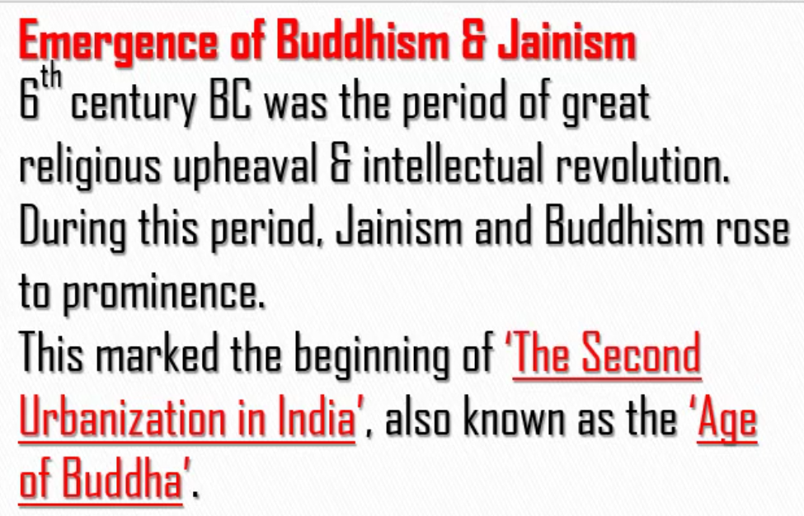
People accepted Buddhism and Jainism whole heartedly because:
They were simple to understand.
People were fed up with killing of animals. As these two religions preached non-violence, people liked them.

Slide 2
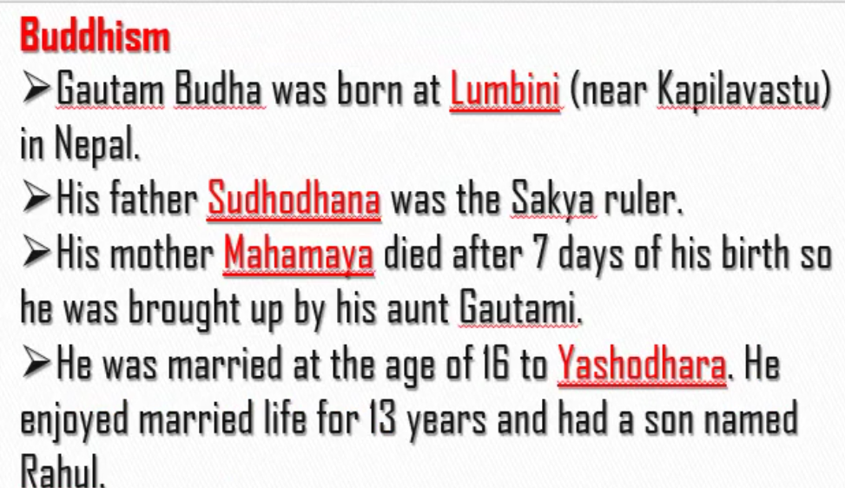
Lumbini (near Kapilavastu) lies in Nepal.
Budha was first called Siddartha before rennounciation.

Slide 3
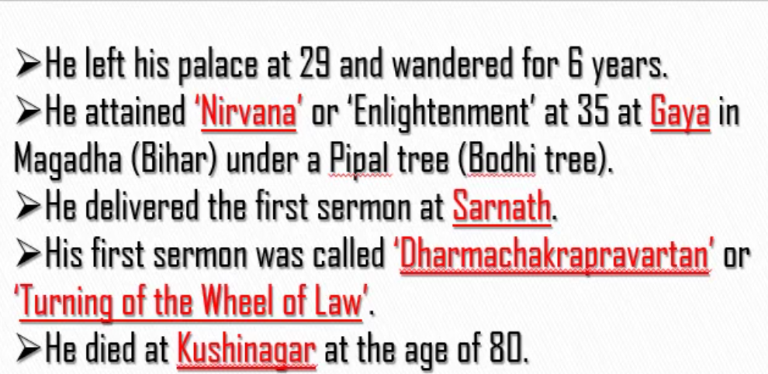
Bodhi Gaya is the place where Buddha got enlightened.
Sermon – Upanyasa.

Slide 4
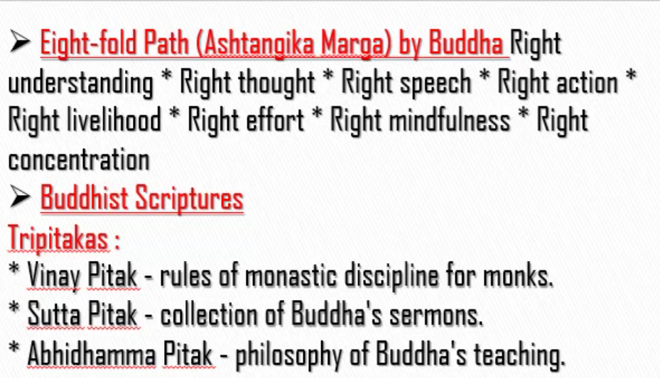
Teachings of Buddha:
Eight fold path(Ashtangika Marga)
Buddhist Scriptures

Slide 5
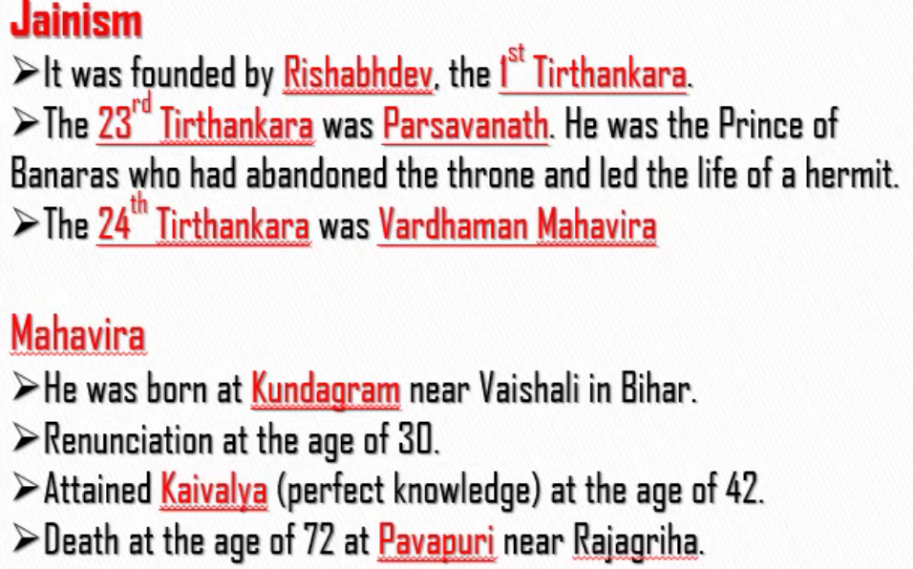
Founder of Jainism – Rishabdev
Actual founder of Jainism – Vardhaman Mahaveer

Slide 6
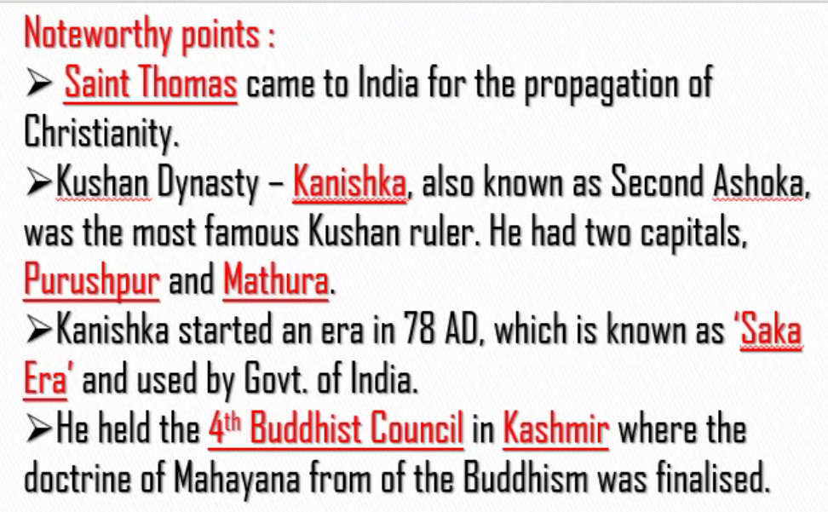
Saint Thomas came to Kerala to spread Christanity. It is the job of the saint to spread the religion.
Just like Ashoka from Mauryan dynasty, Kanishka from Kushan dynasty followed Buddhism. Therefore, Kanishka is known as Second Ashoka. Therefore, the two rulers who followed Buddhism are:
Ashoka – Mauryan dynasty
Kanishka – Kushan dynasty
Mahayana – Buddhist Script

